Slide 1
Linear Regression Modeling
Logistic Regression

Slide 2
Learning Goals
Binary Response Variable
Linear Probability Model
Problems with Linear Probability Model
Logistic Regression
1

Slide 3
The qualitative data with which are dealing, the binary response variable, can always be coded as having two values, 0 or 1. Rather than predicting these two values we try to model the probabilities that the response takes one of these two values

Slide 4
Exmples
In a study to determine the risk factors for cancer, health records of several people were studied. Data were collected on several variables, such as age, sex, smoking, diet, and the family’s medical history. The response variable was, the person had cancer (Y = 1), or did not have cancer (Y = 0).
In the financial community the “health” of a business is of primary concern. The response variable is solvency of the firm (bankrupt = 0, solvent =1), and the predictor variables are the various financial characteristics associated with the firm. Situations where the response variable is a dichotomous variable are quite common and occur extensively in statistical applications

Slide 5
Binary Response Regression Model
Response variable continuous- Linear Regression Model
Qualitative Response variable & Quantitative / Qualitative regressors- Dummy Variable Regression
How to model Qualitative Response Variable?
- Labor force participation (Yes=1, no=0) depends on unemployment rate, average wage
rate, education, family income.
- US presidential elections. Vote Democratic candidate (=1), vote Republican candidate
(=0) depends on rate of GDP growth, unemployment, whether a candidate runs for
re-election (a dummy)
- Onset of heart disease depends on age, exercise (yes / no), smoking (yes / no)
All the response variables are qualitative in nature.

Slide 6
Questions:
Two critical questions:
Can we run a usual linear regression and interpret the outcome?
Since the response variable is qualitative in nature, what do you predict in this case?
We run a linear regression and answer both questions together.

Slide 7
A Business Problem:
We consider 1340 bodily injury liability claims from a single state , USA using a 2002 survey conducted by the Insurance Research Council (IRC)
The survey is conducted in order to understand the characteristics of the claimants who choose to be represented by an Attorney when settling a claim
The profits of an Insurance firm is often found to be dependent on whether the claimant appoints an Attorney or not- appointment of an Attorney can often increase the amount the claimant can claim from the firm
An insurance firm may be interested in finding the probability of a claimant appointing an Attorney
Depending on the demographic characteristics of the claimants who appoint an Attorney, the firm aims to design different policy instruments for different target groups

Slide 8
Linear Regression
Consider the “claimant” dataset
Dummy Variable ATTORNEY: Attorney=0, if yes
=1, if not
Predict the outcome whether claimant is represented by an attorney or not on the following-
Claimant’s age –CLMAGE (D₁)(in years)
Claimant’s sex- CLMSEX(D₂)(0 if Male, 1 if Female)
Claimant’s marital status- MARITAL (D₃) (0 if married,1 if single,2 if widowed,3 if divorced)
Whether the claimant was wearing seatbelt –SEATBELT (D₄) (0 if yes, 1 if no)
Whether the driver of the claimant’s vehicle was uninsured-CLMINSUR (D₅) (0 if yes, 1 if no)
The claimant’s total economic loss (in thousands) -LOSS (X)
Specify the regression:
Y= β₀+ β₁D₁+ β₂D₂+ β₃D₃+ β₄D₄+ β₅D₅+ β₆X+ ε

Slide 9
Conditional Expectation:
Now what to predict?- Only two possibilities for the response variable-
Either claimant is attorney, or not.
Given a set of values of explanatory variables , can we predict with 100% certainty that the claimant is represented by an attorney/not?
Of Course, the only thing we can sensibly try to predict is the probability that the claimant is represented by an attorney given a set of values for the explanatory variables
Like in linear regression, we predict the regression function:
E(Y| X)= β₀+ β₁D₁+ β₂D₂+ β₃D₃+ β₄D₄+ β₅D₅+ β₆X
Conditional Probability: But interpretation different! Now it represents the probability that the claimant is not represented by an attorney given the set of values of the explanatory variables- E(Y| X) is the conditional probability that the event Y will occur given X

Slide 10
Linear Regression Output of proposed model:
Coefficients:
Estimate Std. Error t value Pr(>|t|)
(Intercept) 0.3293872 0.0555616 5.928 4.11e-09 ***
CLMSEX 0.0860886 0.0296149 2.907 0.00372 **
MARITAL -0.0020250 0.0235048 -0.086 0.93136
CLMINSUR 0.1438686 0.0499335 2.881 0.00404 **
SEATBELT -0.1194189 0.1102862 -1.083 0.27913
CLMAGE 0.0003384 0.0007514 0.450 0.65257
LOSS -0.0105399 0.0014182 -7.432 2.17e-13 ***
---
Signif. codes: 0 ‘***’ 0.001 ‘**’ 0.01 ‘*’ 0.05 ‘.’ 0.1 ‘ ’ 1
Residual standard error: 0.4838 on 1084 degrees of freedom
(249 observations deleted due to missingness)
Multiple R-squared: 0.06706, Adjusted R-squared: 0.0619
F-statistic: 12.99 on 6 and 1084 DF, p-value: 3.202e-14
Regression Output, dummy (0,1) assignment
A snapshot output
Observation no | Given y | Predicted value E(y|X)
1325 | 0 | 0.481165988
1326 | 0 | 0.457571633
1327 | 0 | -0.158865176
1328 | 0 | 0.465798861
1329 | 0 | 0.494928856
1330 | 1 | 0.56770376
1331 | 1 | 0.527868666
Not all predicted values lie between 0 and 1 !
Some predicted values (predicted probability in LPM) is negative!

Slide 11
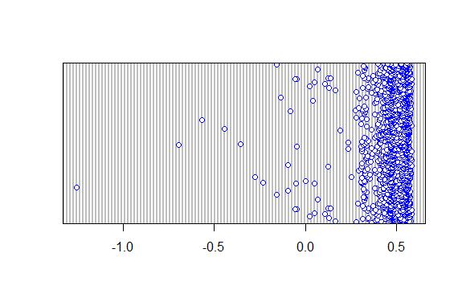
Dotplot of Predicted Probability
From dotplot of predicted probability, we see so many probability values less than 0!

Slide 12
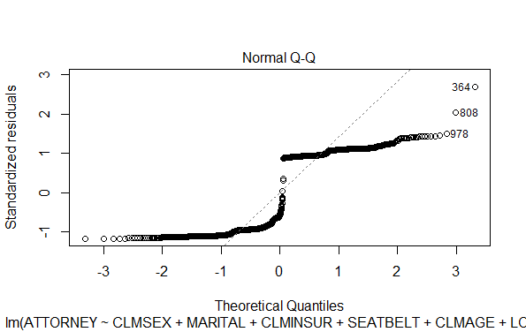
Problems with Linear Probability Model:
1. No guarantee that E(Y|X) will lie between 0 and 1 (Refer to slide 7)
But then probability interpretation doesn’t make sense!
2. Does the normal QQ plot look anything like normal?
Prob Distn of ε_{i}
Y_{i} | εi | Prob
Y_{i} =1 | 1-(β₀+ β₁D₁+ β₂D₂+ β₃D₃+ β₄D₄+ β₅D₅+ βX) | p_{i}
Y_{i} =0 | -(β₀+ β₁D₁+ β₂D₂+ β₃D₃+ β₄D₄+ β₅D₅+ βX) | 1-p_{i}
Cannot be normal!- Distribution is discrete (Bernoulli)!

Slide 13
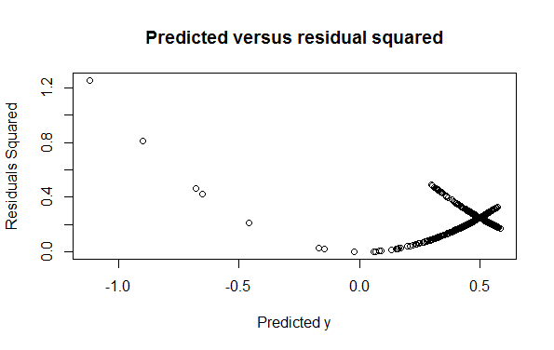
Problems with Linear Probability Model (LPM): Continued
3.
Does the error variance look homoscedastic in any way?
Clear Quadratic pattern!
Look at prob distn of E(Y|X)
Compute error variance-
Var(ε_{i} )=p_{i}(1-p_{i}) (Show it!)
Since p_{i=} E(Y| X)= β₀+ β₁D₁+ β₂D₂+ β₃D₃+ β₄D₄+ β₅D₅+ β₆X, the error variance has to be heteroscedastic!
Logical Validity of the model: β is the Effect of an unit increase in the quantitative variable LOSS on the probability of a claimant being not represented by an Attorney. According to the LPM the probability is linearly decreasing (See sign of β) in loss.
Is it reasonable?

Slide 14

A way…Logistic Function
Logistic regression is named for the function used at the core of the method, the logistic function.
The logistic function, also called the sigmoid function was developed by statisticians to describe properties of population growth of bacteria in ecology, rising quickly and maxing out at the carrying capacity of the environment.
It's an S-shaped curve that can take any real-valued number and map it into a value between 0 and 1, but never exactly at those limits.
Where e is the base of the natural logarithms and value is the actual numerical value that you want to transform.

Slide 15
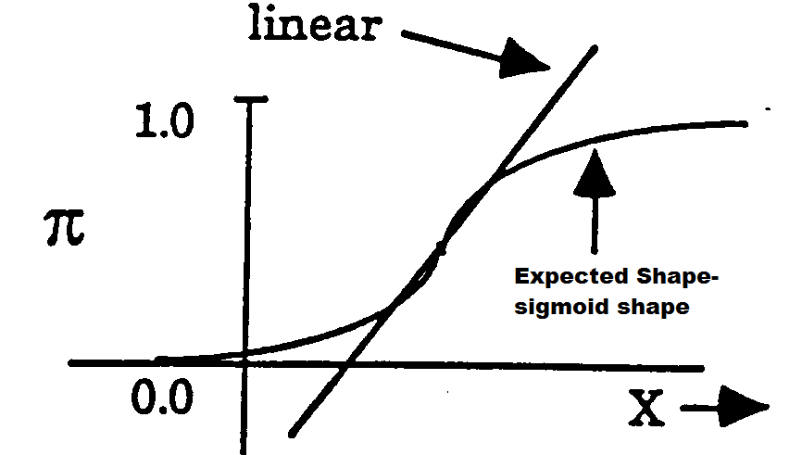
Sigmoid Shape Versus Linear Shape

Slide 16
Logistic Function
P_{i}=E(Y=1| X)= β₀+ β₁D₁+ β₂D₂+ β₃D₃+ β₄D₄+ β₅D₅+ β₆X- LPM representation
Instead we represent: Using Logistic function..
P_{i}=E(Y_{i}=1| X)= 1/ (1+e-(β0+ β1D1+ β2D2+ β3D3+ β4D4+ β5D5+ β6Xi))
For exposition we write:
P_{i}=E(Y_{i}=1| X)= 1/ (1+e^{-(z)})= e^{z}/(1+e^{z})
Where z_{i}= β₀+ β₁D₁+ β₂D₂+ β₃D₃+ β₄D₄+ β₅D₅+ β₆X_{i}

Slide 17
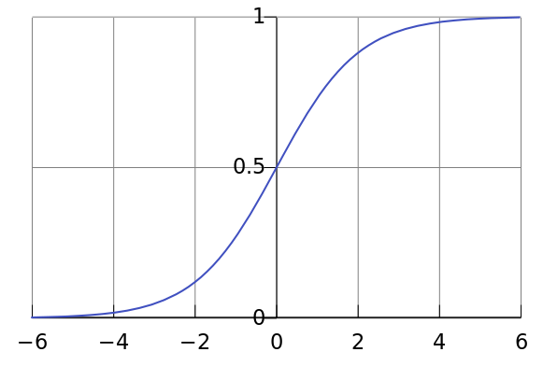

Logistic Curve
Standard Logistic Sigmoid Function

Slide 18
Logistic Curve
Logistic regression uses an equation as the representation, very much like linear regression.
Input values (x) are combined linearly using weights or coefficient values to predict an output value (y).
A key deference from linear regression is that the output value being modelled is a binary values (0 or 1) rather than a numeric value.

Slide 19
Logistic Regression:
The logistic curve takes care of all problems
But how to estimate the model? Non-linear in parameters
Any linearizing transformation?
- Taking logarithm on both sides doesn’t linearize it
- Take ratio: P_{i}/(1-P_{i}) =e^{zi}
- Then take logarithm on both sides:
L_{i}=ln(P_{i}/(1-P_{i})) =Z_{i}= β₀+ β₁D₁+ β₂D₂+ β₃D₃+ β₄D₄+ β₅D₅+ β₆X_{i}
This is called the Logit model/ Logistic Regression.

Slide 20
L_{i}=ln(P_{i}/(1-P_{i})) =Z_{i}= β₀+ β₁D₁+ β₂D₂+ β₃D₃+ β₄D₄+ β₅D₅+ β₆X_{i}
we can see that the calculation of the output on the right is linear again
(just like linear regression), and the input on the left is a natural logarithm of the probability of the default class. This ratio on the left is called the odds of the default class
Odds are calculated as a ratio of the probability of the event divided by the probability of not the event
ln(odds) = B0 + B1 X
Because the odds are log transformed, we call this left hand side the log-odds

Slide 21
Interpretation:
This P_{i} is the probability that a claimant is not represented by an attorney.
Thus (P_{i}/1-P_{i}) is simply the ratio of the probability that a claimant is not represented by an attorney to the probability that he is
This ratio is called the odds. Eg: Odds =2 means that the chances are in the ratio 2 to 1 in favor of not being represented by an Attorney

Slide 22
Learning the Logistic Regression Model Parameters:
The coefficients of the logistic regression algorithm must be estimated from your training data.
This is done using maximum-likelihood estimation. Maximum-likelihood estimation is a common learning algorithm used by a variety of machine learning algorithms
The best coefficients would result in a model that would predict a value very close to 1 for the default class and a value very close to 0 for the other class.
The intuition for maximum-likelihood for logistic regression is that a search procedure seeks values for the coefficients that minimize the error in the probabilities predicted by the model to those in the data
This is often implemented in practice using efficient numerical optimization algorithms
such as Quasi-Newton method / Newton –Raphson method

Slide 23
Logistic Regression:
glm(formula = ATTORNEY ~ CLMSEX + MARITAL + CLMINSUR + SEATBELT +
CLMAGE + LOSS, family = "binomial", data = claimants)
Deviance Residuals:
Min 1Q Median 3Q Max
-1.75252 -1.01326 -0.00579 0.95675 2.77915
Coefficients:
Estimate Std. Error z value Pr(>|z|)
(Intercept) -0.187950 0.260084 -0.723 0.46989
CLMSEX 0.432891 0.135921 3.185 0.00145 **
MARITAL -0.027998 0.110334 -0.254 0.79968
CLMINSUR 0.610617 0.231656 2.636 0.00839 **
SEATBELT -0.787398 0.566209 -1.391 0.16433
CLMAGE 0.006444 0.003483 1.850 0.06434 .
LOSS -0.383399 0.034804 -11.016 < 2e-16 ***
---
Signif. codes: 0 ‘***’ 0.001 ‘**’ 0.01 ‘*’ 0.05 ‘.’ 0.1 ‘ ’ 1
(Dispersion parameter for binomial family taken to be 1)
Null deviance: 1509.5 on 1090 degrees of freedom
Residual deviance: 1283.4 on 1084 degrees of freedom
(249 observations deleted due to missingness)
AIC: 1297.4
Number of Fisher Scoring iterations: 6

Slide 24
Interpretations
Significant Variables- CLMSEX, CLMINSUR,LOSS
The log-odds in favor of a female being not represented by an Attorney is .43 times than that of a male
In other words, the log-odds in favor of a female not being represented by an Attorney is higher than that for male
As loss increases the log-odds in favor of a claimant not being represented by an Attorney reduces
This indicates that as loss increases, it is more probable that a claimant is represented by an Attorney

Slide 25
Impact of a regressor on odds ratio is multiplicative
Let us consider the effect of loss on the odds ratio. Per unit increase in loss, the odds
ratio is exp (-0.38).
For 3 units increase in loss the odds ratio is (exp(-0.38))^3.

Slide 26
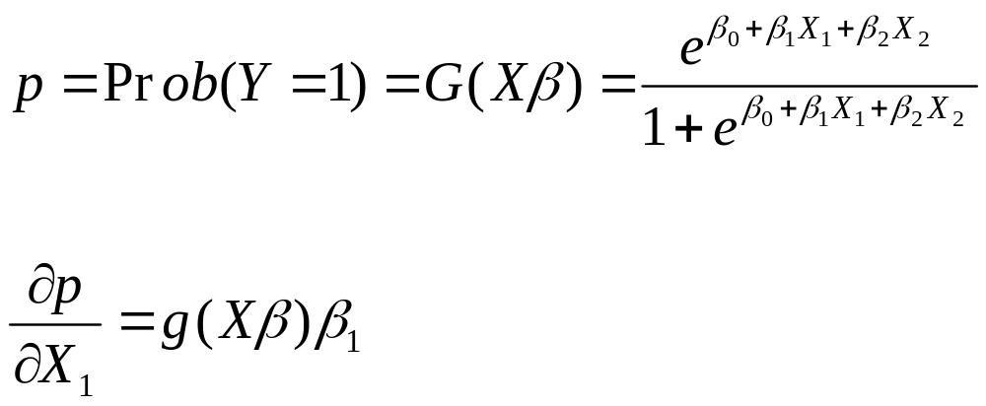


Impact of a regressor on the probability
The probability p that Y =1 is given by
where g is the derivative of G. (Since G is CDF, g is the density function.)
Since the density function is positive, the sign of determines whether the probability increases or decreases with .

Slide 27
From log-odds to Odds Ratio:
Coefficients:
(Intercept) CLMSEX MARITAL CLMINSUR SEATBELT CLMAGE |  |  |  |  |  |  |  | LOSS
0.8286564 1.5417076 0.9723899 1.8415664 0.4550272 1.0064644 |  |  |  |  |  |  |  | 0.68154
Exp(fitted values)- A snapshot
Odds Ratio
2 3 4 5 6
1.645147 1.776298 1.576690 1.871129 2.061934

Slide 28

Model fit
Likelihood
Loglikelihood
Deviance
Deviance
Deviance Is based on the log likelihood of all the parameters estimated by the model.
Null deviance is based on the log likelihood of the intercept parameter when there are no regressors.
The above are analogous to the residual sum of squares and respectively
in the case of linear regression.
Residual deviance and AIC
Residual deviance = -2 log likelihood
AIC = Residual deviance + 2 number of parameters

Slide 29
Diagnostics
Deviance residuals
Pearson residuals
DFBETA
Collinearity

Slide 30
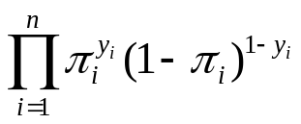
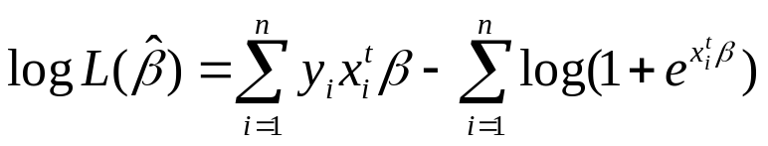
Goodness of fit measures
Likelihood:
Loglikelihood:
Deviance
  Model deviance
    Log likelihood with the parameters estimated by maximum likelihood method
  Null deviance
    Log likelihood without any regressors(Only with intercept): log L(0)

Slide 31
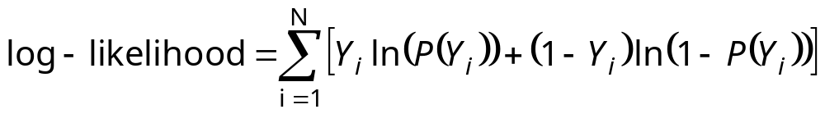
Assessing the Model
The Log-likelihood statistic
  Analogous to the residual sum of squares in multiple regression
  It is an indicator of how much unexplained information there is after the model has been fitted.
  Large values indicate poorly fitting statistical models.

Slide 32
Classification tables (Confusion matrix)
Sensitivity
Specificity
Cut off
ROC

Slide 33
Confusion matrix & Goodness of fit
 | Observed 1’s | Observed 0’s
Predicted 1’s | a | b
Predicted 0’s | c | d
Many counts in a and d boxes and few in b and c boxes indicate good fit.
Sensitivity = a/(a+c)
Specificity = d/(b+d)
High sensitivity and specificity indicate good fit.
 |  | Observed values
 |  | 0 | 1
Predicted Values | FALSE(0) | 380 | 125
 | TRUE(1) | 198 | 393
 | Total | 578 | 518

Slide 34
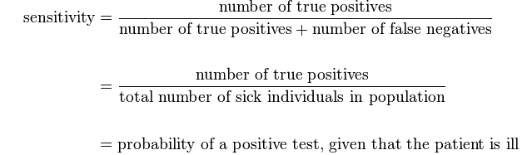
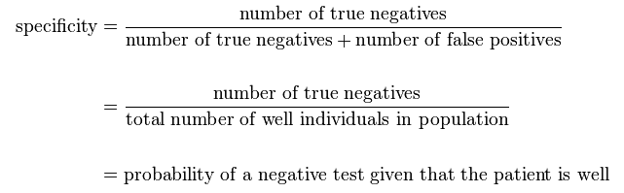
Sensitivity and specificity

Slide 35
ROC curves
Extending the above two-by-two table idea, rather than selecting a single cutoff, we can examine the full range of cutoff values from 0 to 1. For each possible cutoff value, we can form a two-by-two table.
Plotting the pairs of sensitivity versus one minus specificity (True positive vs false positive) on a scatter plot provides an ROC (Receiver Operating Characteristic) curve.
The area under this curve (AUC of the ROC) provides an overall measure of fit of the model.
In particular, the AUC provides the probability that a randomly selected pair of subjects, one truly positive, and one truly negative, will be correctly ordered by the test. By “correctly ordered”, we mean that the positive subject will have a higher fitted value (i.e., higher predicted probability of the event) compared to the negative subject.

Slide 36
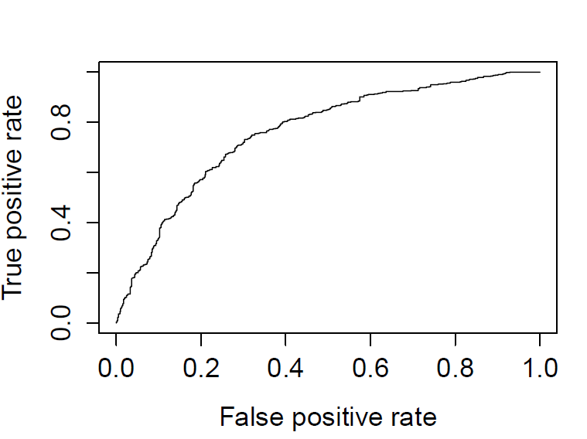
Area under the curve: 0.5

Slide 37
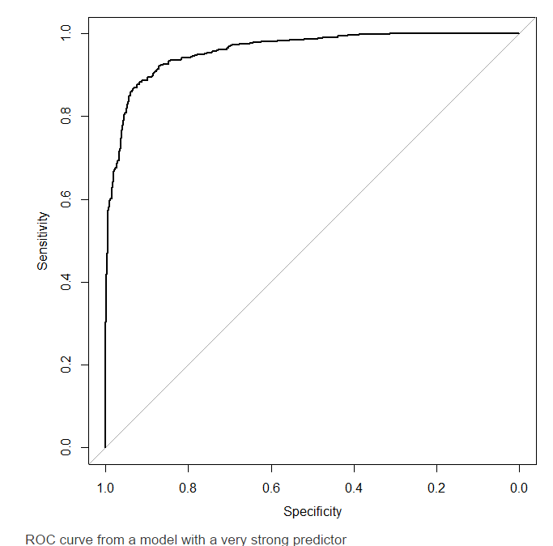
Almost Ideal ROC

Slide 38
Model selection
How many regressors?
Testing for the inclusion of an additional regressor
Forward
Backward
Stepwise
AIC

Slide 39
R-Codes
# Install appropriate packages-
install.packages("aod")
install.packages("ggplot2")
library(aod)
library(ggplot2)
#Logistic Regression
mylogit <- glm(ATTORNEY ~ CLMSEX+MARITAL+CLMINSUR+SEATBELT+CLMAGE+LOSS,data=claimants, family = "binomial")
#Exponentiating back the coefficients
exp(coef(mylogit))
#Finding odds ratio:
fit<-fitted(mylogit)
exp(fit)

